Slide 1
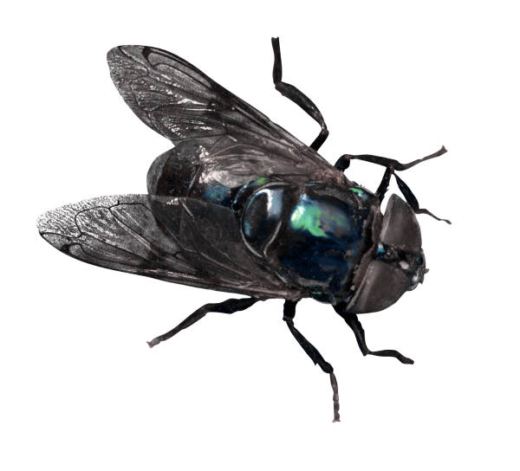
Lord of the Flies
CHAPTER 1

Slide 2
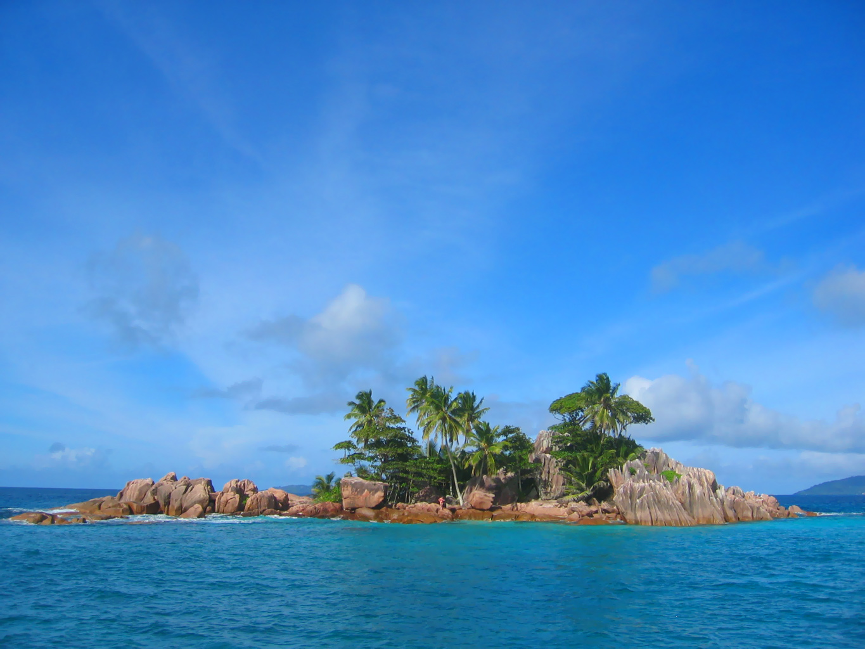
England 1945
The boy with fair hair washes upon the shore and begins to search his surroundings. He sees none of the other boys that were on the plane with him. He appears to be all alone on an island.

Slide 3

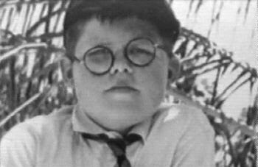
Vines that the fair boy calls “creeper things” seem to dominate much of the landscape approaching a forest off the beach. From a distance the fair boy sees another. He is very fat and searching for something.
RALPH
PIGGY

Slide 4
The boys talk and the fair boy introduces himself as Ralph, while the fat boy lets out his secret. “They used to call me Piggy,” he shares and asks that he not be called by this name. Ralph makes no promises.
The two boys search for others and in the process find a conch shell. Piggy suggests to Ralph, that Ralph blow into the conch to summon any others who might be on the island. Piggy would do it himself but his asthma hinders him from producing the necessary power.
Conch shell symbolizes order, control, and the power of civilization. Ralph uses this as “talking stick” and as a way to call a meeting.

Slide 5
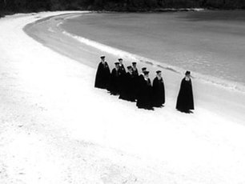
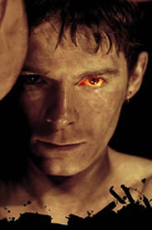
Once the trumpet-like sound of the shell exhales over the island, children begin to gather. Older boys, including a set of twins named Sam and Eric, emerge, as do much younger boys.
Ralph and Piggy see a dark, foreboding creature approaching. "The creature was a party of boys, marching...” This party is a choir of boys, dressing in matching black robes led by a boy name Jack Merridew. Other choir boys include Simon, Roger, and Maurice.
Jack

Slide 6
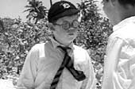
As the boys sort out names, Ralph betrays Piggy by telling Jack and the others the unwanted nickname. Jack victimizes Piggy from the beginning.
The boys decide that in order to get anything accomplished they must have a leader.
Jack nominates himself because he can sing a C sharp. Roger suggests they vote. Ralph wins the vote because he possess the conch shell. Jack is obviously disgruntled that he has lost, and outwardly pouts. A power struggle has begun!

Slide 7
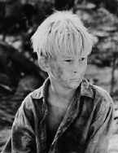
Now that a leader has been chosen, Ralph makes his first decision. He, Jack and Simon go to scout the island. Ralph senses something good in Simon against Jack’s protests that Simon is worthless because he faints all the time.
Piggy vocalizes his disappointment at not being chosen to venture on the island, and Ralph explains to him that “You're no good on a job like this.”
Simon
PREDICT:
WHAT HAPPENS ON THEIR EXCURTION? WHAT DO THEY FIND?

Slide 8
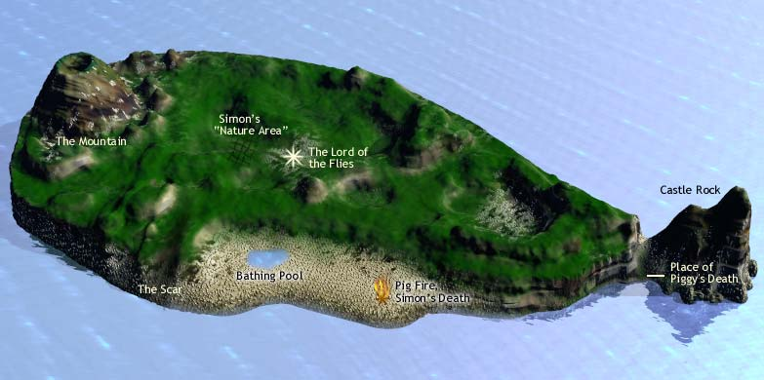
The boys climb the mountain and can see the entire island. They come to the conclusion that there are no grown-ups anywhere, but they believe it is a good island with fruit trees, a bathing pool, and fresh water.
The boys find animal tracks in the forest. They follow the tracks and find a piglet caught in the creeper vines. Jack draws a pocket knife to kill the pig, but waits too long, so the pig gets away. The boys disagree on how best to kill a pig.
Create a dialog between the three boys. How do they suggest they kill the pig based on what you know about each character?

Slide 9
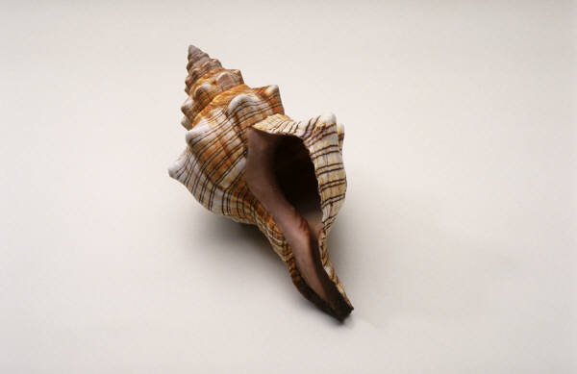
SIGNIFICANCE AND SYMBOLISM
The Pig: Besides the obvious connection of Piggy’s name to the pigs on the island, the hunt for the pig represents Jack’s descent into savagery, his desire for a kill, and his thirst for power.
The encounter with the pig is foreshadowing for later events.
The Conch: represents POWER, ORDER, CIVILIZATION, and Control. The boys begin by respecting the conch and depend upon the conch to help them set rules and imitate their former lives.

Slide 10
Lord of the Flies
CHAPTER 2

Slide 11
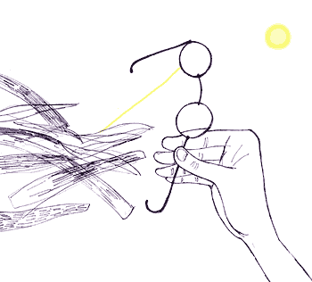
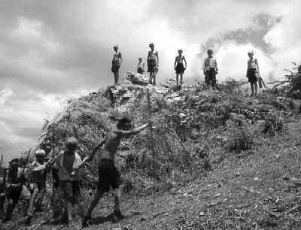

FIRE ON THE MOUNTAIN
Based on the title and the pictures, PREDICT what will happen in this chapter. What role do you think your character will play and why?

Slide 12
Ralph emerges as the leader he was voted to be by calling a meeting. He and Jack share the details of the exploration and ensure that while there are no grown-ups, they are on a good island.
To keep order Ralph, with Jack’s help, sets rules:
1. “We can’t have everyone talking at once. We’ll have to have ‘Hands up’ like at school” p.33
2. The person who has the conch shell is the only person who can speak.
Jack exclaims excitedly, “We’ll have rules! Lots of rules!”
Why would Jack, who was snubbed out of leadership, wish to have so many rules on the island?

Slide 13

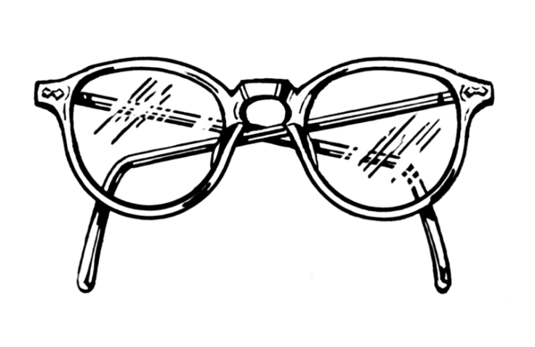
Piggy, always the voice of reason, is the only person to bring up the need to be rescued. The other boys had not thought about this yet. They were having too much fun playing, swimming, and exploring.
He clings to the conch shell because he values the power it gives him, and the connection he feels to the adult world. He feels like the only adult amongst a bunch of kids.

Slide 14

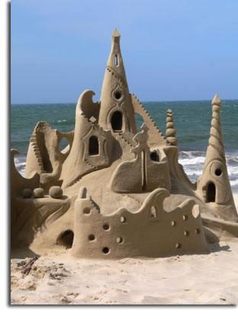
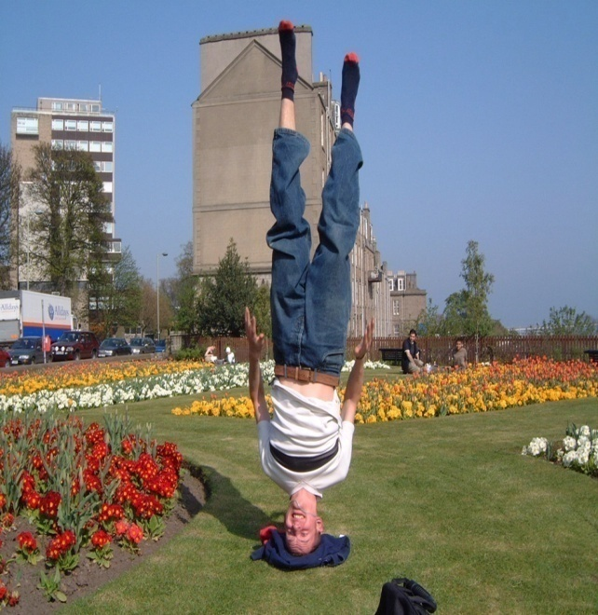

Ralph, being the good mediator he is, puts everyone at ease by exclaiming that they can do both:
Try to get rescued
  *his father is in the navy; therefore he feels
  more confidant about this than the rest
Have fun while they are on the island.
Ralph likes to do headstands!

Slide 15
However, one of the littlest boys on the island reaches for the conch shell. As children are often the first to sense evil, the boy explains that he has been a “beastie” on the island. The beast is described as a snake-like thing that sticks mostly to the forest, and comes out to hunt at night.
Ralph says:
“You couldn’t have seen a beastie, a snake-thing, on an island this size…you only get them in big countries, like Africa, or India.”
Jack says:
“Ralph’s right of course. There isn’t a snake-thing. But if there was a snake we’d hunt it and kill it. We’re going to hunt pigs to get meat for everybody. And we’ll look for the snake too-”
One way we learn about characters is through what they say.
What do these responses say about their characters?

Slide 16
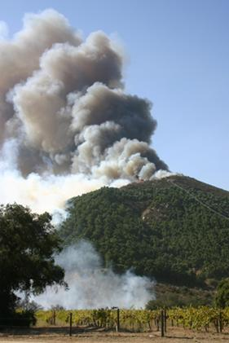

In the spirit of action, and feeling like he is inspiring the group, Ralph suggests a plan! “We can help them find us. If a ship comes near the island they may not notice us. So we must make smoke on top of the mountain. We must make a fire!
Without questions or hesitation all the boys race to trudge up the mountain. Ralph hangs in the back with Piggy who exclaims that they are all, “acting like a crowd of kids!”
Q: (Why is this statement ironic? What does this say about Piggy?)
Ralph follows his tribe and leaves Piggy behind.

Slide 17
All the boys, minus Piggy, help to gather wood and twigs to build their great signal fire. As they admire their successful fire, Ralph and Jack exchange an ashamed look. Neither one really knows how to start the fire.
Just as they begin to admit defeat, Piggy meanders up to the wood pile. “His specs- use them as burning glasses,” Jack announces, and leaps on Piggy snatching the glasses.
A fire blazes, and Piggy is left clinging to the shell, begging for his glasses to be returned.

Slide 18
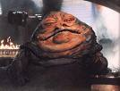

Now that plans are taking action Ralph seizes the opportunity to set more specific rules:
1. Someone will have to look after the fire to keep it going and make sure it is smoking.
*Jack volunteers his choir, or his hunters as they are now referred, to take on this important task. The boys clap wildly at his generosity.
2. Wherever the conch shell is will be the meeting place.
*However, whenever Piggy speaks he is harassed and told constantly to “shut up fatty” by Jack, despite his possession of the all-powerful conch shell.
It is not my fault my aunty owned a candy store.

Slide 19
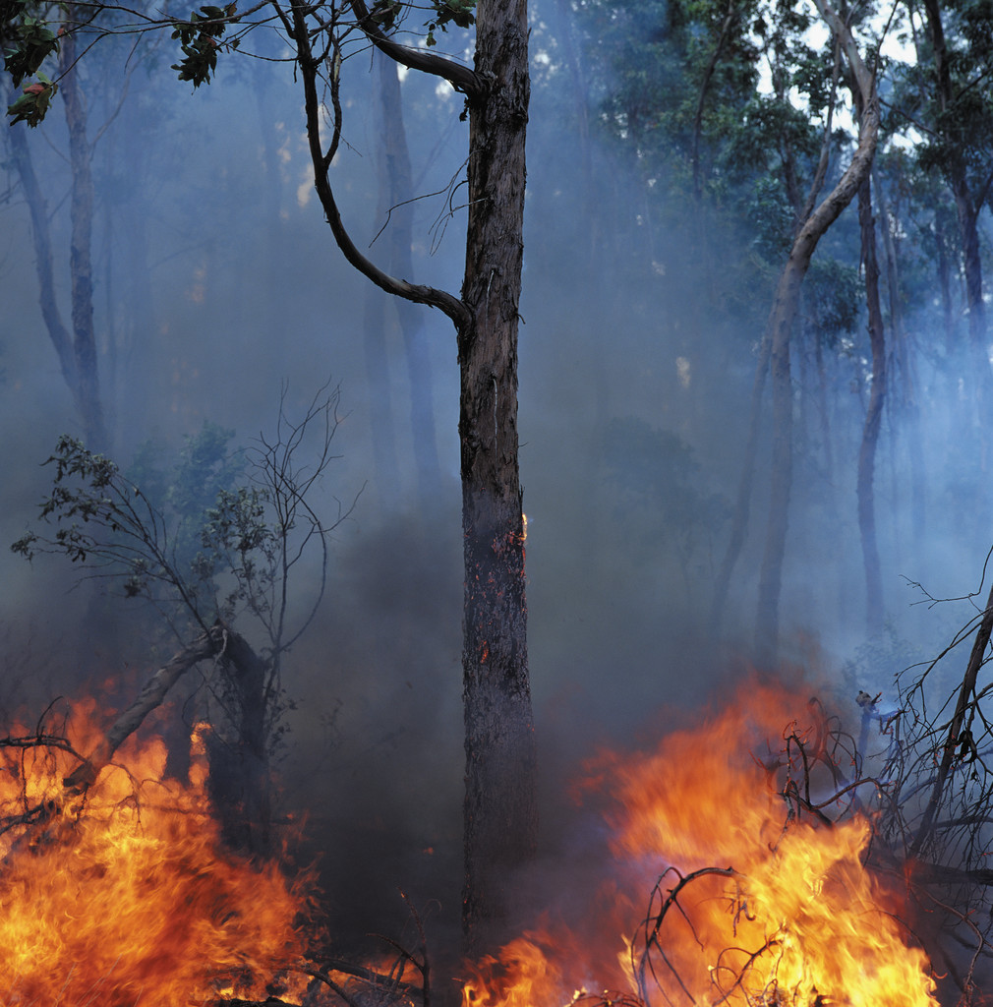
During the argument, no one noticed the fire spreading out of control. The fire slithered out to the forest using the vines as food and wound its way up the trees, igniting everything in its path. A quarter of a mile was engulfed in smoke and flame.
Piggy looked frightened but scolded the group. He warned them against acting on impulse “like a bunch of kids.”
His admonishment continued as he exclaimed that they didn’t even know all the littluns names.
Hey, where is that little kid with the birthmark that was afraid of the beastie? Last time we saw him he was wandering in the forest…

Slide 20
Significance and Symbolism
The Beastie: The boys are beginning to let the fear of the unknown get to them. The questions are: Is there really a beast? What do the boys really have to fear?
WHAT DO YOU THINK IS THE PURPOSE OF THE BEAST?
Piggy’s Specs: Used to CREATE fire, these glasses represent intelligence, foresight, and the connection to the adult world Piggy is the only “adult-like” presence that exists on the island. He is the constant, and often annoying, reminder of reality.
The FIRE: for the boys fire represents hope and rescue, but like the boys themselves fire has the potential to create as well as destroy.

Slide 21
Lord of the Flies
CHAPTER 3

Slide 22
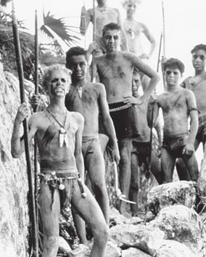
Carrying a stick sharpened into a makeshift spear, Jack trails a pig through the thick jungle, but it evades him. Irritated, he walks back to the beach, where he finds Ralph and Simon at work building huts for the younger boys to live in.
Help me!

Slide 23
Ralph is irritated because the huts keep falling and while Ralph and Simon work, most of the other boys splash about and play in the lagoon. He complains that all the boys act excited and energized by the plans they make at meetings, but none of them is willing to work to make the plans successful.
Ralph points out that Jack’s hunters have failed to catch a single pig. Jack claims that although they have so far failed to bring down a pig, they will soon have more success.
-This comment makes Jack want to hunt even more! Here begins his obsession!

Slide 24
Ralph: in this chapter is concerned that the boys only care about having fun. They are not helping or being responsible. The littluns are also plagued increasingly by nightmares.
He wants to build shelters because:
1)They need protection from rain, floods, and bad weather.
2)The boys fear the beast and feel more comfortable having protection.
Jack: can only think about meat and hunting. He constantly repeats “We need meat!”
Simon: Listens to and helps Ralph but is too quiet to stand up to Jack.

Slide 25
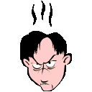
Jack is angry with Ralph for scolding him. They try to put their differences aside by going swimming but their mutual anger festers. They are beginning to resent one another.
Jack
Ralph

Slide 26
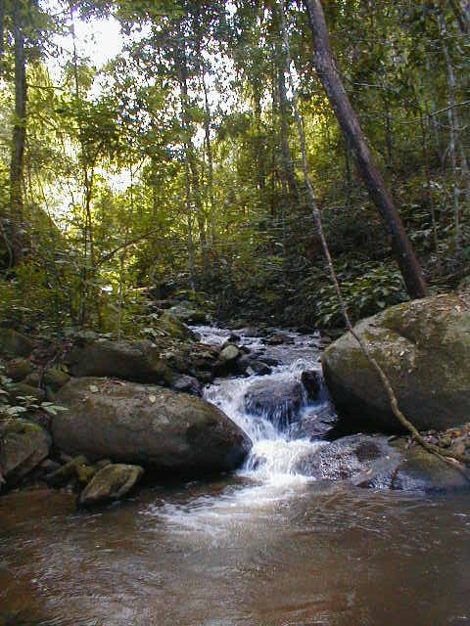


In the meantime, Simon wanders through the jungle alone. He helps some of the younger reach fruit. He walks deeper into the forest and eventually finds a peaceful, beautiful open space full of flowers, birds, and butterflies. Simon looks around to make sure that he is alone, then sits down to take in the scene, marveling at the abundance and beauty of life that surrounds him.

Slide 27
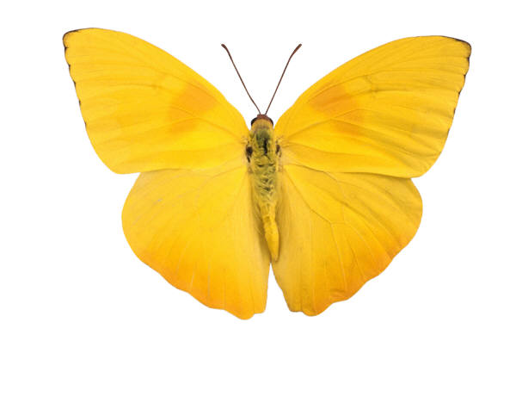
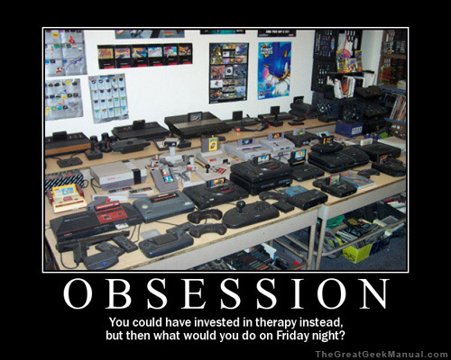
Significance and Symbolism
Jack: His obsession with the hunt begins to grow, although the conflict between civilization and savagery still favors civilization.
Simon’s nature area: His appreciation for nature demonstrates the internal goodness the other boys do not have. The other boys have learned their manners while Simon was born with his. He contrasts Ralph and Jack in this chapter.

Slide 28
What are some common things for teenagers to become obsessed with? Children? Adults?
What is obsession?
What are the consequences of obsession?

